Slide 1
Repetition
Notes:
Purpose
To introduce the concept of repetition/loop).
Learning objective
By the end of this tutorial children should be able to:
Understand that concept of repetition/loops.

Slide 2
Repetition
Sequence
Notes:
Introduce students to key vocabulary for this lesson:
Sequence: When we sequence things, we arrange them in a particular order. Sequence-based algorithms are made from a precise set of instructions.
Repetition : This is the recurrence of actions or events. For example, we eat our lunch each lunchtime and might watch a favourite soap every evening. Repetition in programming means to repeat the execution of certain instructions.

Slide 3
Notes:
Patterns are everywhere in nature.
These patterns recur in different contexts, Natural patterns include symmetries, trees, spirals, meanders, waves, foams, tessellations, cracks and stripes
Ask students to explore the images shown, can they see the pattern produced by nature? Can they think of any other patterns?

Slide 4
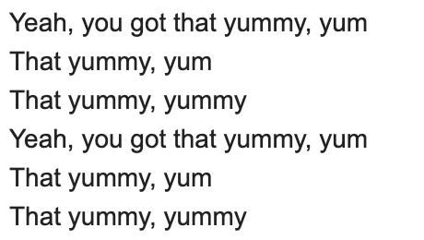
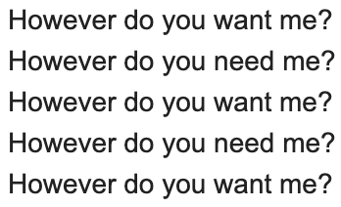
Notes:
Explore repetition by looking at popular songs, can children see repetition in these songs?
(You may want to change these songs to nursery rhymes or songs that are current at the time).
You could also print extracts from songs and ask your students to highlight the repetition.
On the board, you may want to highlight the repetition.

Slide 5
Notes:
Show students an example of how the repetition in the songs may be displayed with the use of loop blocks.

Slide 6
Why is repetition important? Repetition allows algorithms to be simplified by stating that certain steps will repeat until told otherwise. This makes designing algorithms quicker and simpler because they don't need to include lots of steps.
Notes:
Explain to students about the importance of repetition in coding.

Slide 7
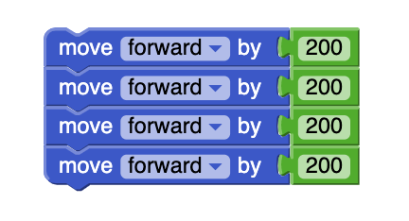
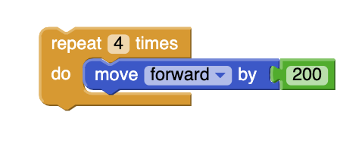
Notes:
Ask students to look at these two pieces of code. Get students to physically trace though the code, what does the code do? Are they the same or different? Which code is the most efficient?

Slide 8
Walk forward two steps
Turn right a quarter turn
Walk forward two steps
Turn right a quarter turn
Walk forward two steps
Turn right a quarter turn
Walk forward two steps
Turn right a quarter turn
Notes:
Ask your students to explore these instructions/algorithms.
Your students can explore this by drawing or walking out the in (i.e. getting up and moving though the code)
What does it do? (Makes you draw/walk in a square shape)
Can your students think of how they can add repetition to make this simpler and more concise?

Slide 9
} x4
Notes:
Ask your students to explore this instruction/algorithm.
Your students can explore this by drawing or walking out the in (i.e. getting up and moving though the code)
What does it do? (Makes you draw/walk in a square shape)
By adding repetition has it made the algorithm simpler and more concise?

Slide 10
Notes:
Can students make instructions/algorithms for other shapes/polygons?
Can their use repetition to make the instructions/algorithms concise?

Slide 11
🕺💃
Notes:
Ask students to look at the instructions/algorithms they have made, can they now make a simple dance?
Allow students space and time to design their simple dance.
Students could do this in groups of six and have large sheets of paper and pens to write/design their dance.
You may want to give students a piece of music to dance to, they are loads of of great examples in audio.lgfl.net.

Slide 12
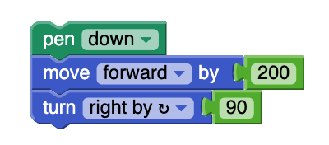
Can you use the idea of repetition to make penguin draw a square?
Notes:
Plenary:
Show students this simple video, can students think of how they can add a loop block with this code to create a square?
You may want your student to explore this by drawing or walking out the code (i.e. getting up and moving though the code)

Slide 13
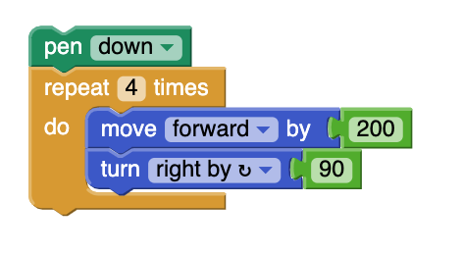
Notes:
Plenary:
Show students this simple video, can students think of how they can add a loop block with this code to create a square.
You may want your student to explore this by drawing or walking out the code (i.e. getting up and moving though the code).

